Slide 1
Windows 10 Module 3
Working with Windows Apps

Slide 2
Module Objectives
Display apps
Search for apps
Install apps from the Windows Store
Uninstall apps
Manage apps using multiple desktops
Customize the Start menu
Group apps on the Start menu

Slide 3
Display Apps (Slide 1 of 3)
Windows 10 Start menu displays tiles that represent apps installed on your computer
Does not show all apps installed
Use All apps command to display
Apps list in alphabetical sections
App icons
Folder icons (Windows accessories)

Slide 4
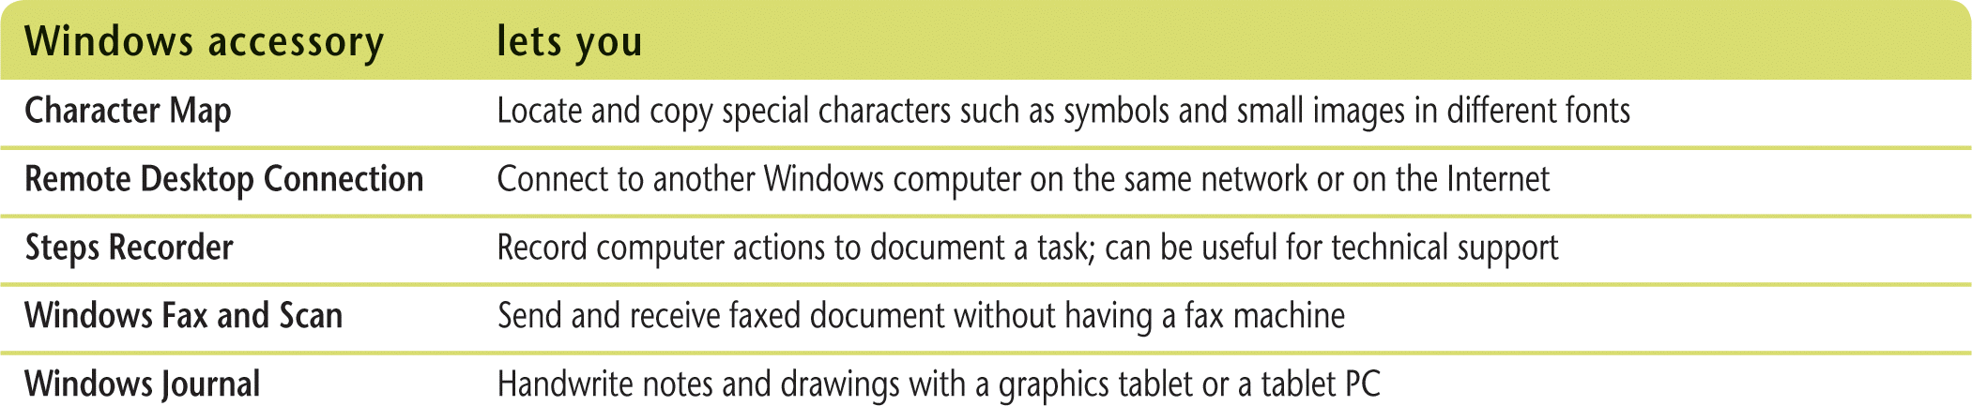
Display Apps (Slide 2 of 3)
Windows Accessories apps
Paint, NotePad, WordPad, Snipping Tool, Sticky Notes
Additional Windows accessories

Slide 5
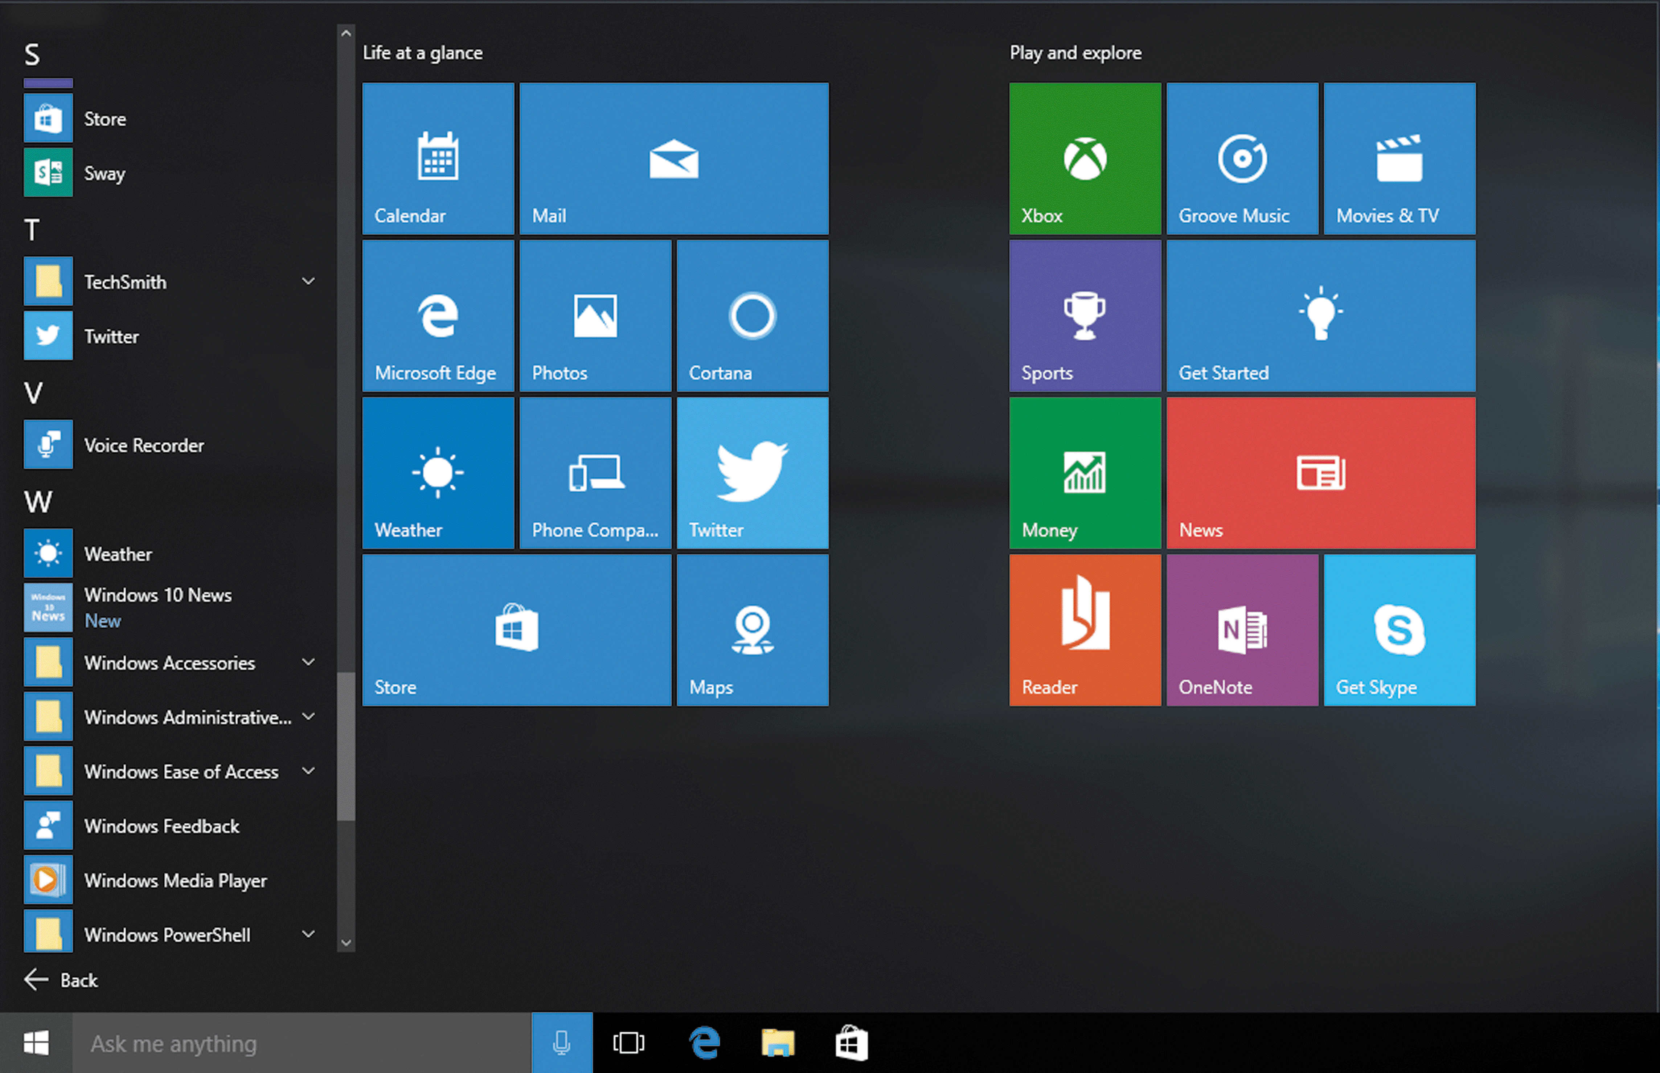
Display Apps (Slide 3 of 3)
All apps alphabetical groupings

Slide 6
Search for Apps (Slide 1 of 3)
Use the All apps menu
Can be time consuming
Use the search box on Start menu
More direct
Cortana
Search result categories (Best match, Apps, Settings, Folders)

Slide 7
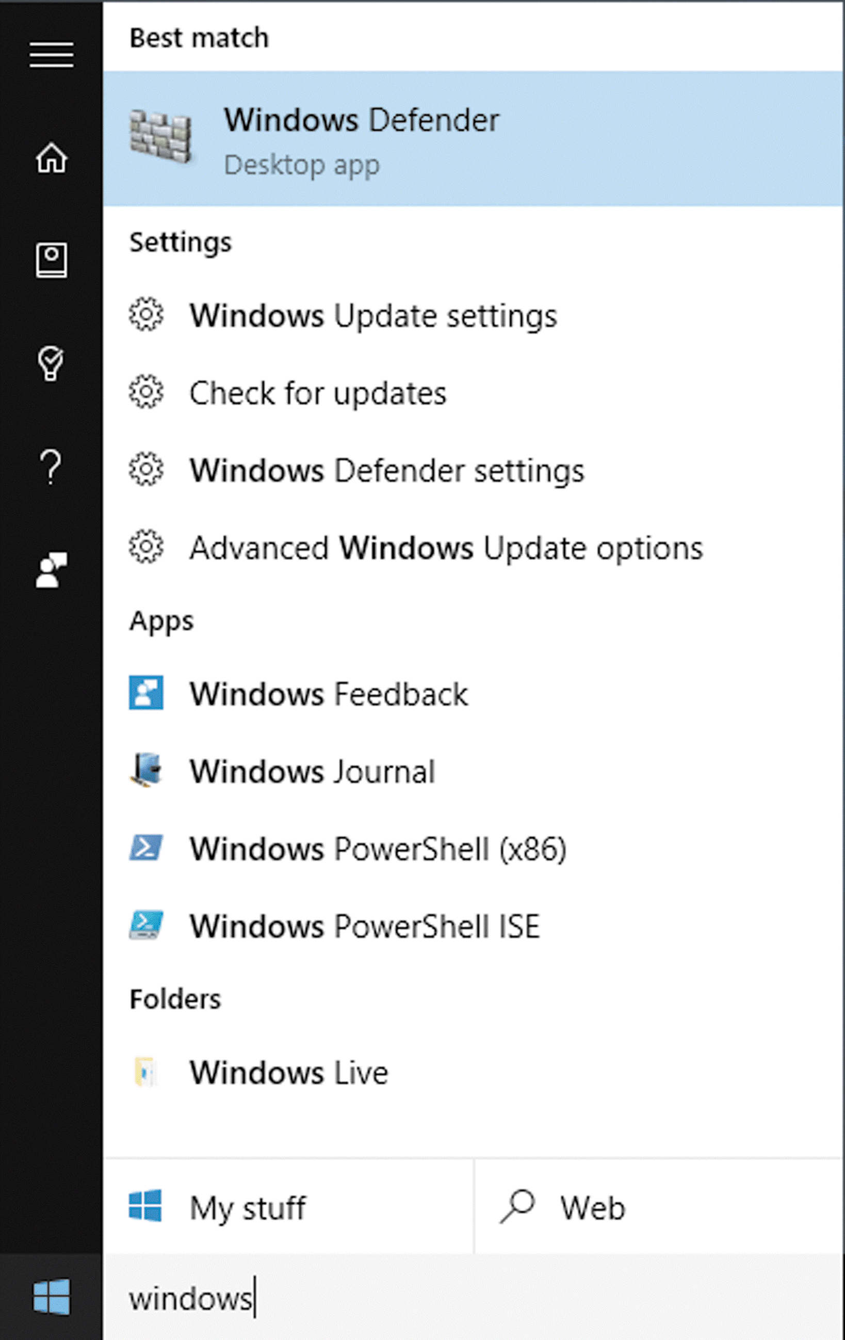
Search for Apps (Slide 2 of 3)
Cortana menu showing search results for “windows”

Slide 8
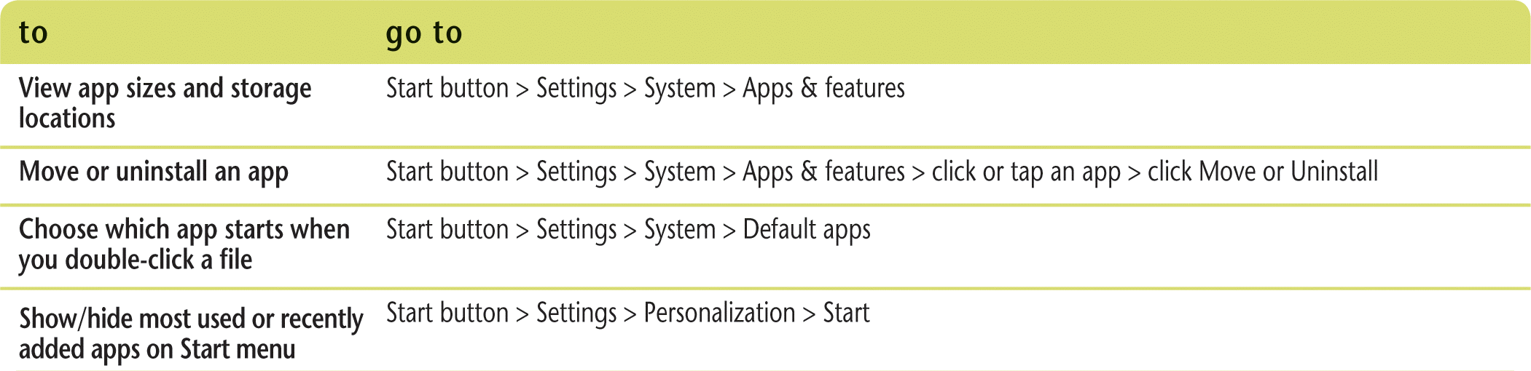
Search for Apps (Slide 3 of 3)
Managing your apps

Slide 9
Install Apps from the Windows Store (Slide 1 of 2)
Windows 10 comes with a default set of apps
Purchase and install additional apps from the Windows Store
Access the Windows store from Start menu or taskbar
Search by category or by app name
Microsoft account is basis of Windows Store account
Install a purchased app on up to ten devices
Use Windows Store to update apps

Slide 10
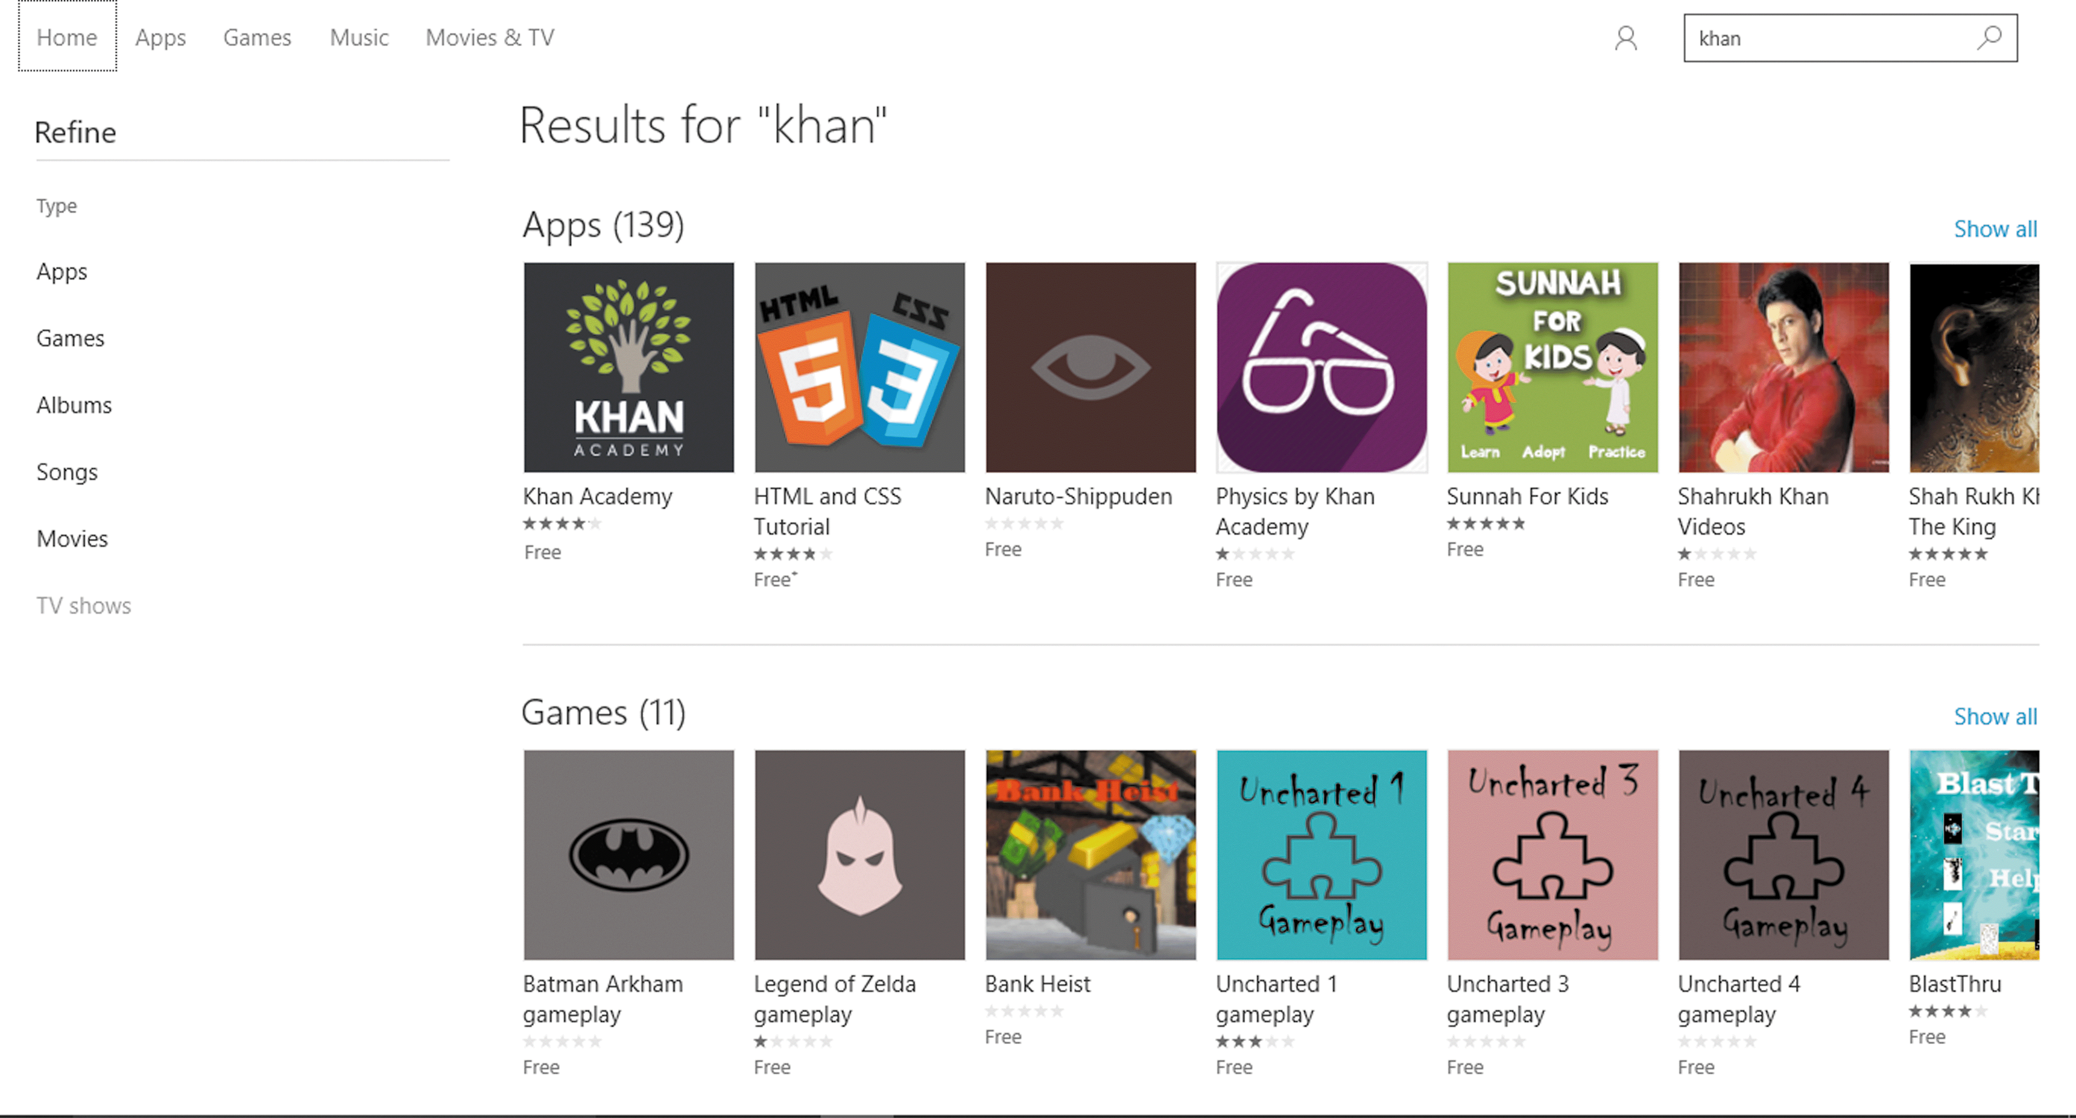
Install Apps from the Windows Store (Slide 2 of 2)
Search results in the Windows Store

Slide 11
Uninstall Apps
Uninstall one or more apps at the same time from the Start menu or All apps listing
An alert message will pop-up to confirm the uninstall
View all your apps
My Library in Windows Store to view purchased apps
Settings app to view all apps you own

Slide 12
Manage Apps using Multiple Desktops
Can create a second desktop, a virtual desktop
Place different apps on each desktop
Can switch between desktops
Use Task View to manage
Each desktop has its own taskbar
If you close a desktop with an open app, app automatically moves to other desktop

Slide 13
Customize the Start Menu
Access Windows 10 apps and features on Start menu
Can customize the Start screen
Add apps or accessories
Customize look and function
Start menu has a default set of pinned items
Unpin an item to remove shortcut from the Start menu

Slide 14
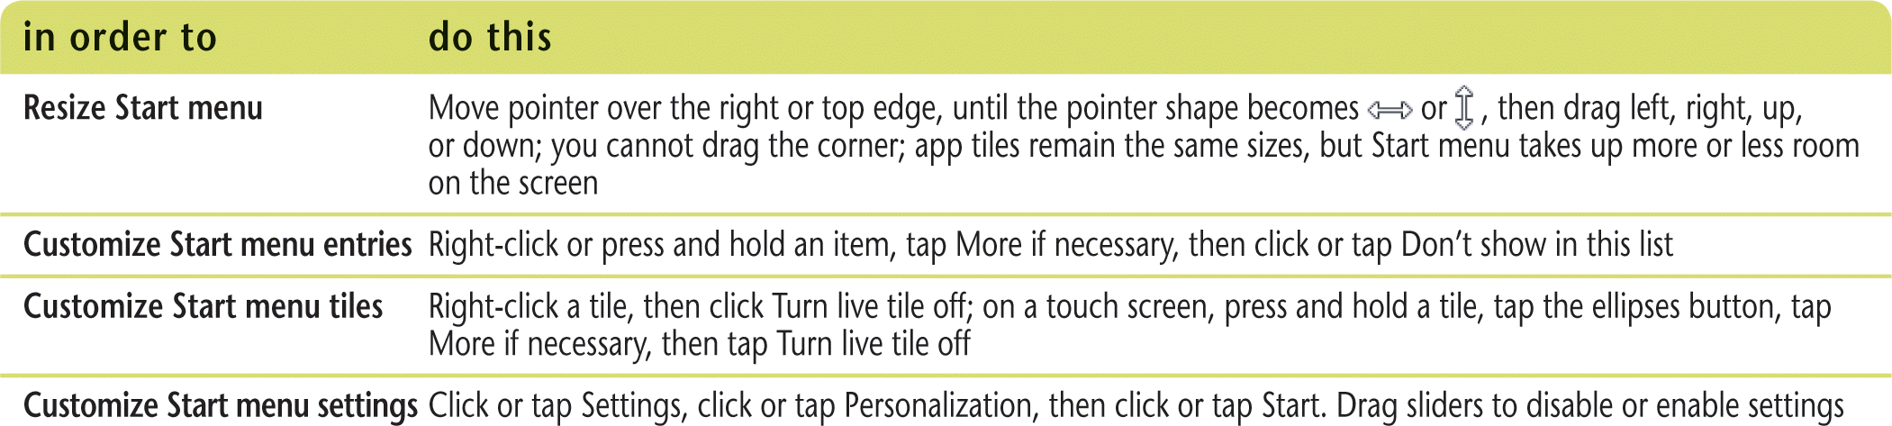
Group Apps on the Start Menu (Slide 1 of 2)
Find apps easier by using groups
Use an existing group or create a new group by repositioning apps on Start menu
Can easily resize app tiles or name groups
Customizing Start menu elements

Slide 15
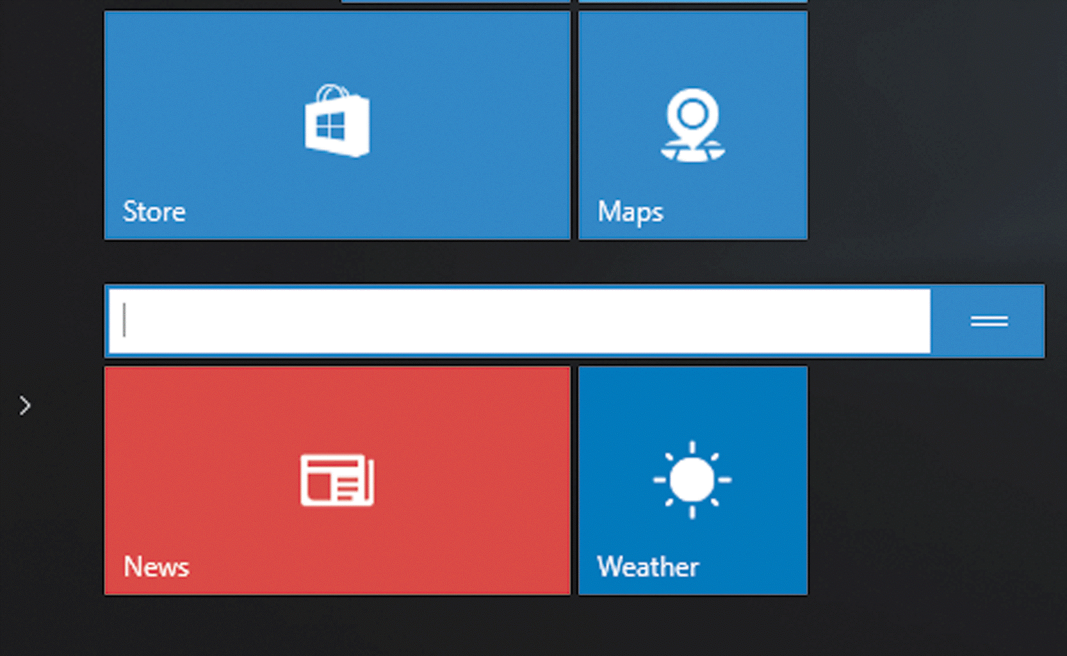
Group Apps on the Start Menu (Slide 2 of 2)
Naming a new group
Group title bar above new group

